Slide 1
CMP303 Networking
Fraser Barker(1600196)

Slide 2
Application
Networked Boid Simulation
Server
Client
Interaction

Slide 3
Architecture
Client-Server
Peer-peer
Hybrid client-server
Aiming for client-server
Better scalability
P2P problems
New host
Advantage?

Slide 4
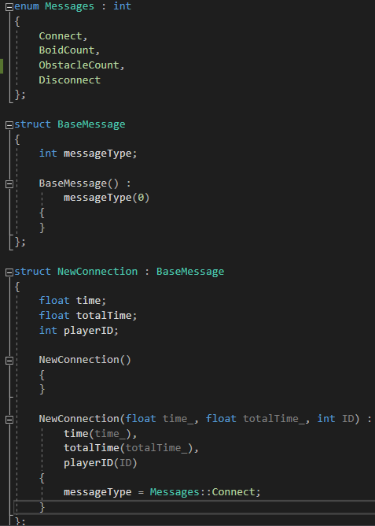
Protocols
Application layer protocols designed
Messages
Enums
Boids
Obstacles
Transport layer protocols chosen
UDP
Speed
Connectionless
One socket to talk to multiple
Less overheard

Slide 5
Network API
SFML
Familiarity
Ease of networking
Packets
Better showcase vs Unreal/Unity
Easier than WinSock

Slide 6
Structure
Non-blocking
Rendering
Calculating
Sending/Receiving
Pros
Cons

Slide 7
Prediction/Interpolation
Linear vs Quadratic
Linear attempted
Boid update
Recalculating position every frame
Prediction needed?

Slide 8
Critical Discussion
Use TCP for connection/disconnection
Connection class
Improve/add prediction
More interaction
Sf::Int
Clumsy Testing
Max players 3 – Boid information.
Max latency 50ms -250ms, 250ms – 500ms
Packet loss – 25%, 50%+, 75%?
Throttling – 50%, 75%+ delay
Duplicates – 50%, 75%+ Double boids
Out Of Order – 50%, 75%+ seems fine too?
Tamper – 50% - Server issues.
All?

Slide 9
Questions?

